Slide 1
DDWD3723
SOFTWARE DEVELOPMENT
GET HOTEL SYSTEM
GROUP NAME :
Prepared by
TAN JIN WAN
MUHAMMAD LUQMAN HAZIM BIN SULAIMAN
MUHAMMAD ANAZ AZZAMUDDIN BIN AZHAR
NABIL AIMAN BIN ADNAN

Slide 2
Proposal Submission
GROUP MEMBER
ORGANIZATION / CLIENT
PROJECT APPROVAL
Choose your group number, do group of 6 person and maximum of 7 person in a group
Identify one potential organization / client
Confirm your group number and the suitability of the organization / client chosen with the student
PROJECT PLANNING
PROBLEM STATEMENT / PRODUCT VISION STATEMENT
Explain roles each member with organization chart and explain how you planning the project.
The due date will be depends on lecturer.
Identify the problem for that organization / client and write the problem statement and product vision statement using the template given.

Slide 3
Due Date
Project Planning Due Date
PROPOSAL SUBMISSION : 11 SEPTEMBER 2023 (BEFORE 9.00 AM) - HARDCOPY
PROPOSAL PRESENTATION : 18 SEPTEMBER 2023
SPRINT 1
WEEK 4 : Meet with stakeholders to gather requirements.
WEEK 5 : Create architectural diagrams.
WEEK 6 : Set up development environment.
WEEK 7 : Implement core functionalities.
SPRINT 2
WEEK 8 : Continue features development
WEEK 9 : Integrate third-party APIs or components.
WEEK 10 : Conduct unit testing
WEEK 11 : Perform integration testing
SPRINT 3
WEEK 12 : User acceptance testing
WEEK 13 : Bug fixing and issue resolution
WEEK 14 : Perform final testing, review, and quality checks
WEEK 15 : final product delivery

Slide 4
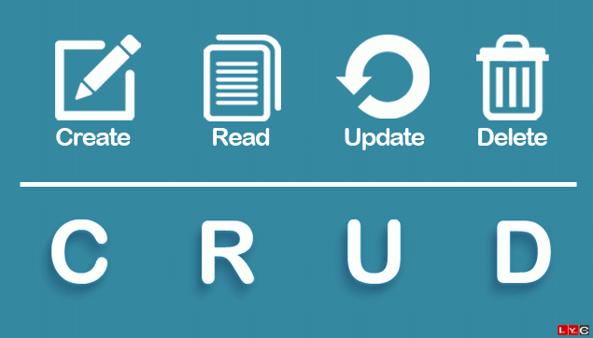
Project Requirement
Software Development – Project Requirement
MUST HAVE EXAMPLE OF EXISTING PROJECT
DATABASE (SQL / NOSQL)
CRUD
FRIENDLY USER INTERFACE
HYBRID - APPS & WEBSITE (ADMIN & USER)
WEBSITE (ADMIN & USER)
MUST USE FRAMEWORK
USE DOMAIN (MUST ONLINE)
APPS (ADMIN & USER)
MUST USE ONLINE DATABASE
IoT
DEVICE (RASPBERRY PI / ARDUINO)
APPS / WEB (ADMIN & USER)
MUST USE ONLINE DATABASE
CRUD WAS EXCLUDED

Slide 5
Project Information
Overview of project information.
TEAM NUMBER | GROUP 1 | SECTION
CLIENT / ORGANIZATION | RIVERFRONT SENTRAL HOTEL
PROJECT TITLE | GET HOTEL SYSTEM
PROGRAMMING LANGUAGE | JAVA AND XML
DATABASE | FIREBASE SQL

Slide 6
Project Information
Overview of project information.
PROJECT TITLE :GET HOTEL SYSTEM
PROJECT AIM | THE AIM OF THIS PROJECT IS TO DEVELOP A WEBSITE SYSTEM FINAL YEAR PROJECT FOR A HOTEL SYSTEMM
OBJECTIVES | Develop an intuitive and easy-to-use interface for the "Get Hotel" system to enhance the overall user experience, making it accessible to a wide range of users, including those with varying levels of technological proficiency. Implement advanced data structures algorithms to analyze user preferences, displaying all relevant costs and fees, fast bookings, and behavior. The system should provide personalized hotel recommendations to enhance user engagement and satisfaction. Obtaining new customers by creating website that can advertising media to gain customer trust.
PROJECT SCOPES | The "Get Hotel" system aims to create a comprehensive and user-centric platform for efficient hotel booking focused on both tourists and locals. In the other hand, this system is suitable for the management and staff to organize bookings. It also helps new customers to make registration and apply promotion for booking.

Slide 7
Project Information
Overview of project requirement.
PROJECT TITLE : GET HOTEL SYSTEM
METHODOLOGY | WATERFALL METHODOLOGY
LIST OF SOFTWARE FOR (DOCUMENTATION & DEVELOPMENT) | TRELLO XAMPP NOTEPAD MICROSOFT WORD MICROSOFT POWER POINT
LIST OF HARDWARE FOR (DOCUMENTATION & DEVELOPMENT) | LAPTOP PC

Slide 8
Problem Statement
Overview of problem statement.
PROJECT TITLE : GET HOTEL SYSTEM
THE PROBLEM OF | Lack efficiency, user-friendliness, and personalized experiences for customers.
AFFECTS | Users, administration, staffs.
THE IMPACT OF WHICH | Face issues related to transparency in pricing, limited search filters, and inadequate information about the amenities offered by various hotels.
A SUCCESSFUL SOLUTION SHOULD BE | Leverage advanced technologies to provide personalized recommendations based on user preferences, previous bookings, and feedback.

Slide 9
Product Vision Statement
Overview of product vision statement.
PROJECT TITLE : GET HOTEL SYSTEM
FOR | Provide simplicity and efficiency in hotel booking process.
WHO | Tourist, locals, administration, staff
THE GET HOTEL SYSTEM | Comprehensive platform that revolutionizes the way users discover, book, and manage their hotel stays.
THAT | Stands out with unique features and advantages
UNLIKE | Other products on the market, our system focuses on a user-centric design, making the booking process intuitive and enjoyable.
OUR PRODUCT | Provide UP-TO-DATE Information of the ROOM

Slide 10
SWOT Analysis
SWOT Analysis for the project.
Strength
Weakness
One of the first if not the only system for the hotel.
Have In-app purchase.
S
W
Still in the early stage of full developed application.
Lack of awareness and marketing to reach potential users.
Threats
T
O
Opportunities
Changes in regulations potentially affecting its operation.
Economic downturn.
Partnerships with travel agencies
Expanding the system to cover international markets.

Slide 11
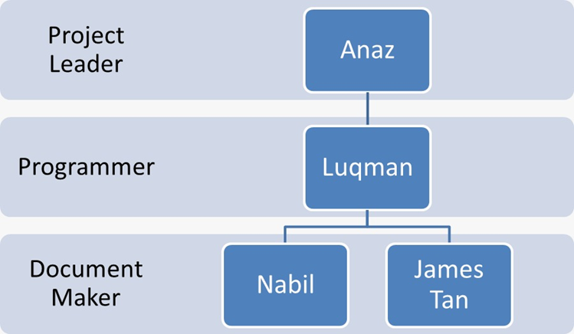
Team Member
Introduction to team member.
ORGANIZATION CHART
PICTURE, ROLES & IN PROPER ORGANIZATION CHART

Slide 12
Team Member
Introduction to team member.
TABLE OF ROLES AND RESPONSIBILITIES
TABLE WITH DETAILS OF THE JOB
No. | Member Name | Position | Roles
1. | Anaz | Project Leader | Managing the project team
2. | Nabil | Document Maker | Ensure all documentation is up-to-date
3. | James Tan | Document Maker | Ensure all documentation is up-to-date
4. | Luqman | Programmer | Writing code and building products

Slide 13
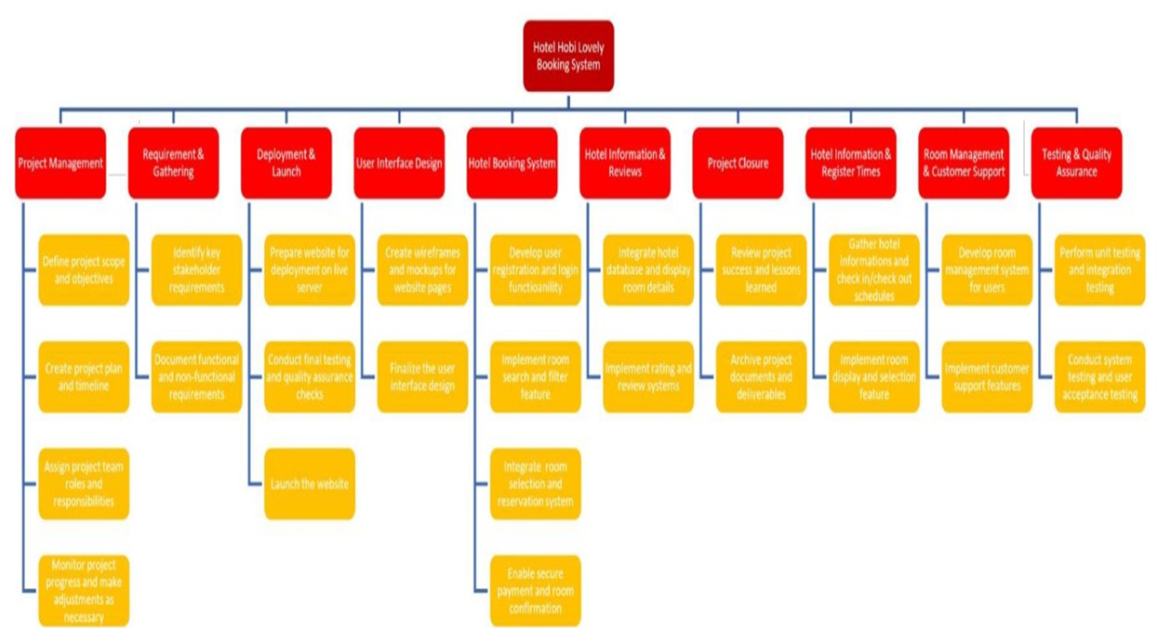
Project Planning
Project Planning Details
PROJECT PLANNING DETAILS
WORK BREAKDOWN STRUCTURE

Slide 14
Project Features
Project Features Details
PROJECT FEATURES
List all the function that should have in this project, categorize the function by it user.
Customers
Administration
Allowing customers to easily navigate through a wide range of search filters.
Ensuring a quick and efficient booking process.
Provide a high level security for customers’ personal information and data.

Slide 15
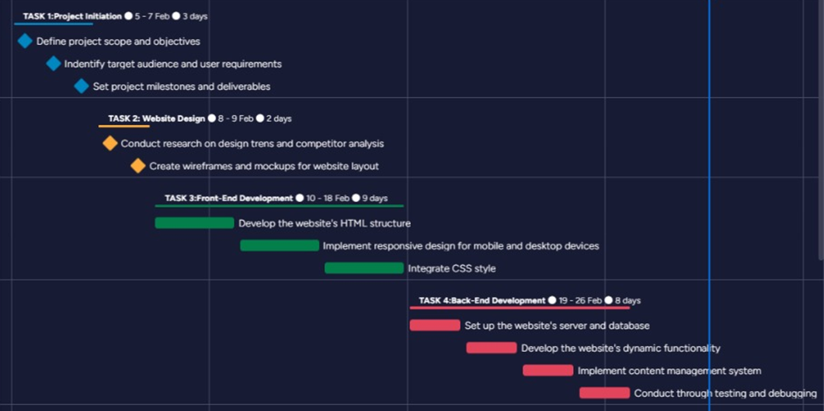
Project Planning
Project Planning Details
PROJECT PLANNING DETAILS
GANTT CHART

Slide 16
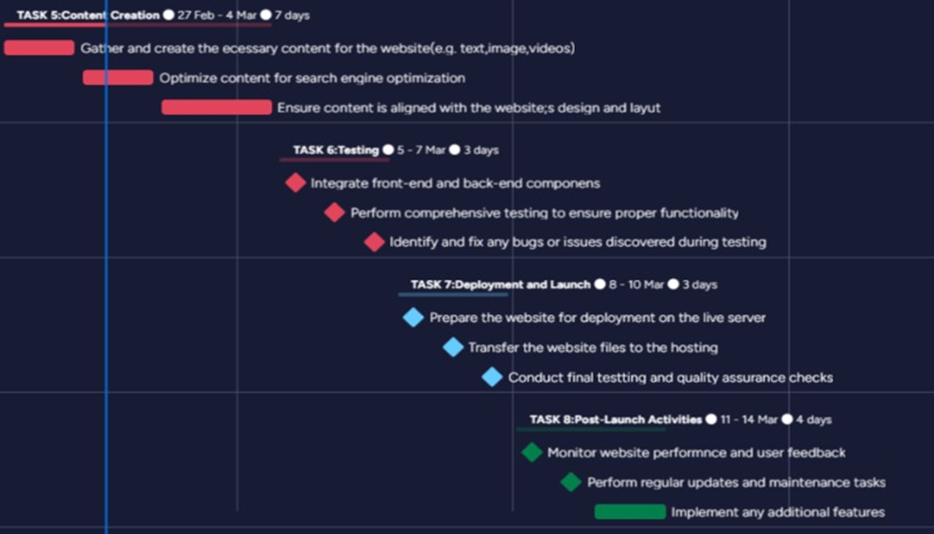

Slide 17
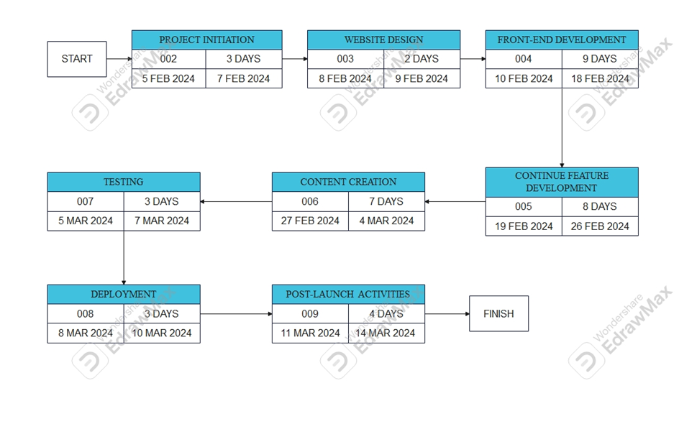
Project Planning
Project Planning Details
PROJECT PLANNING DETAILS
PERTT CHART

Slide 18
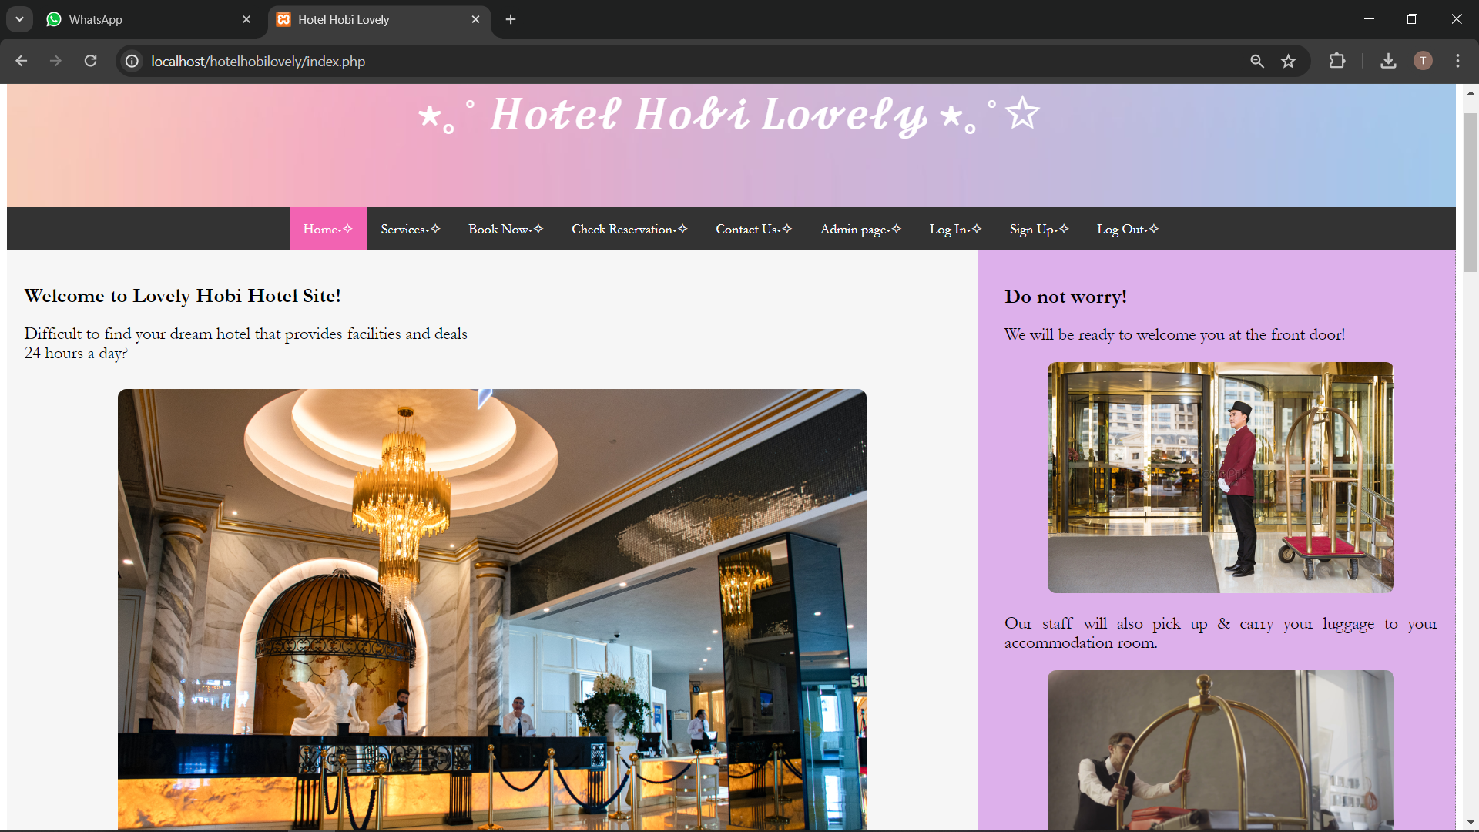
Home Page

Slide 19
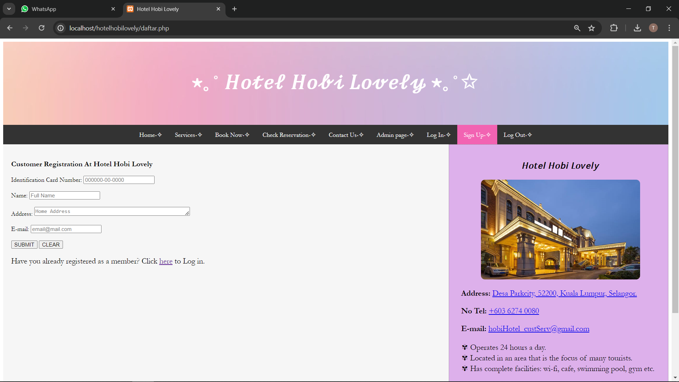

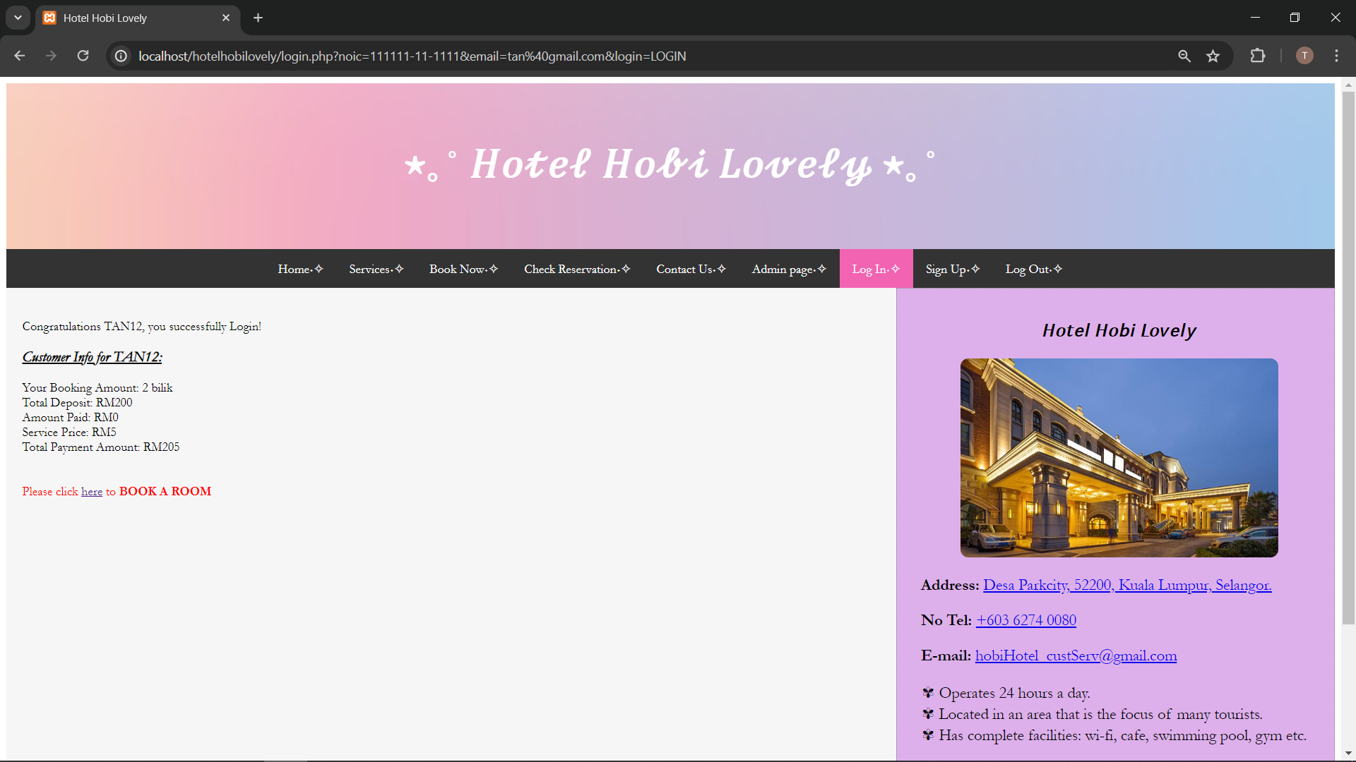
Sign Up Page
Log In Page

Slide 20
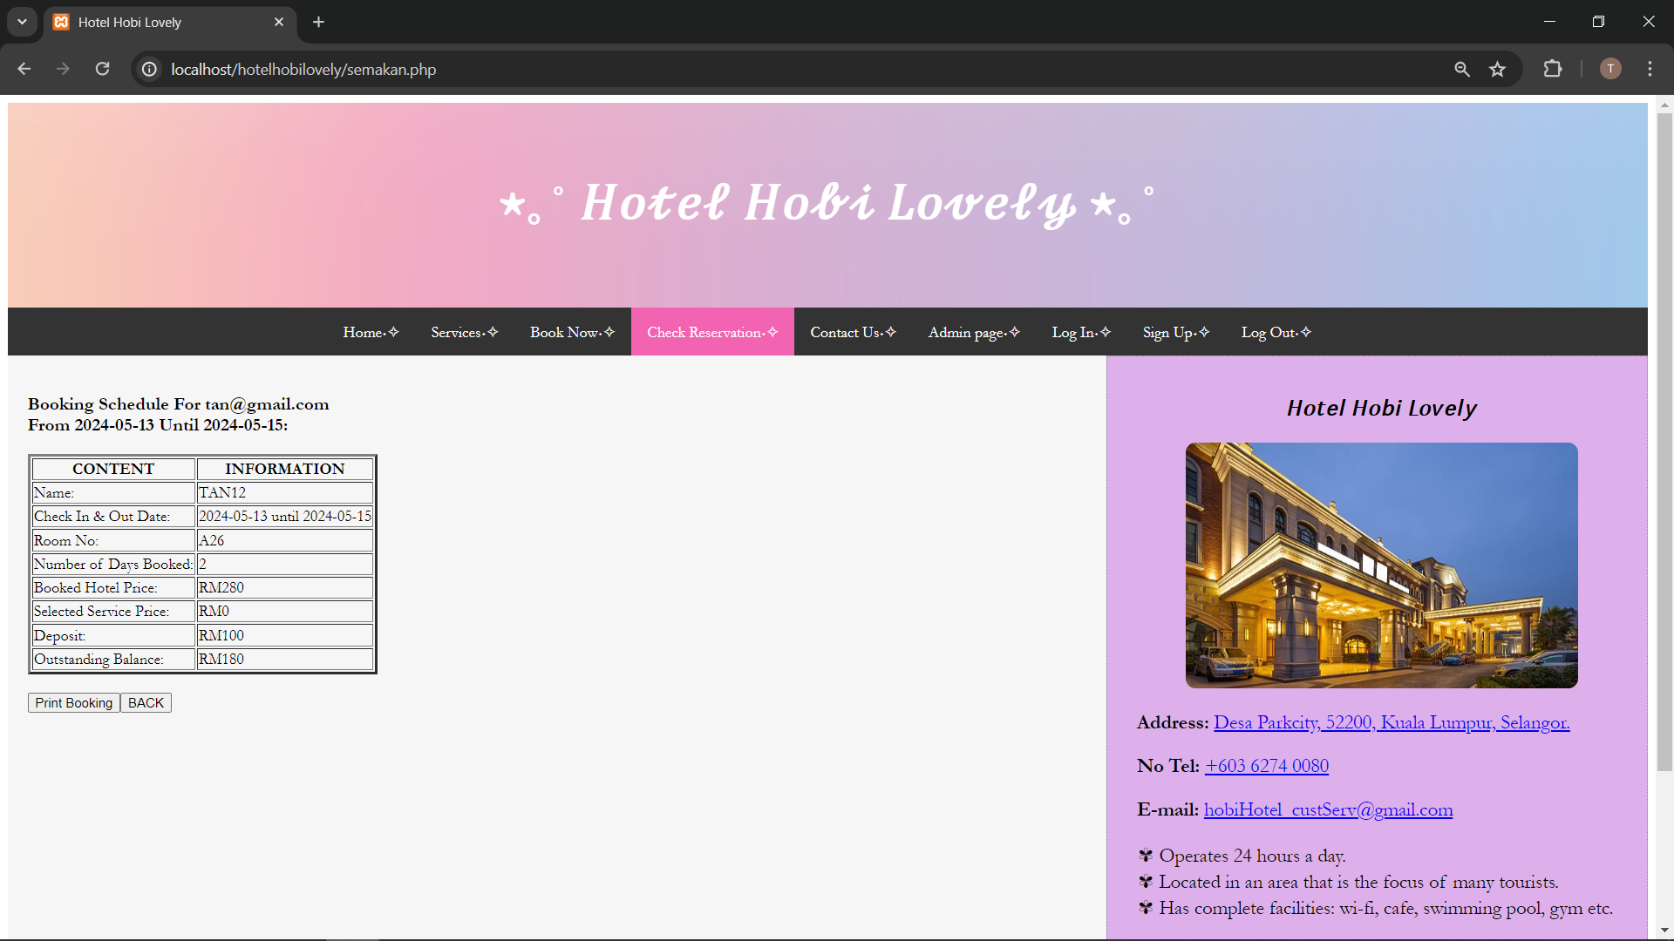
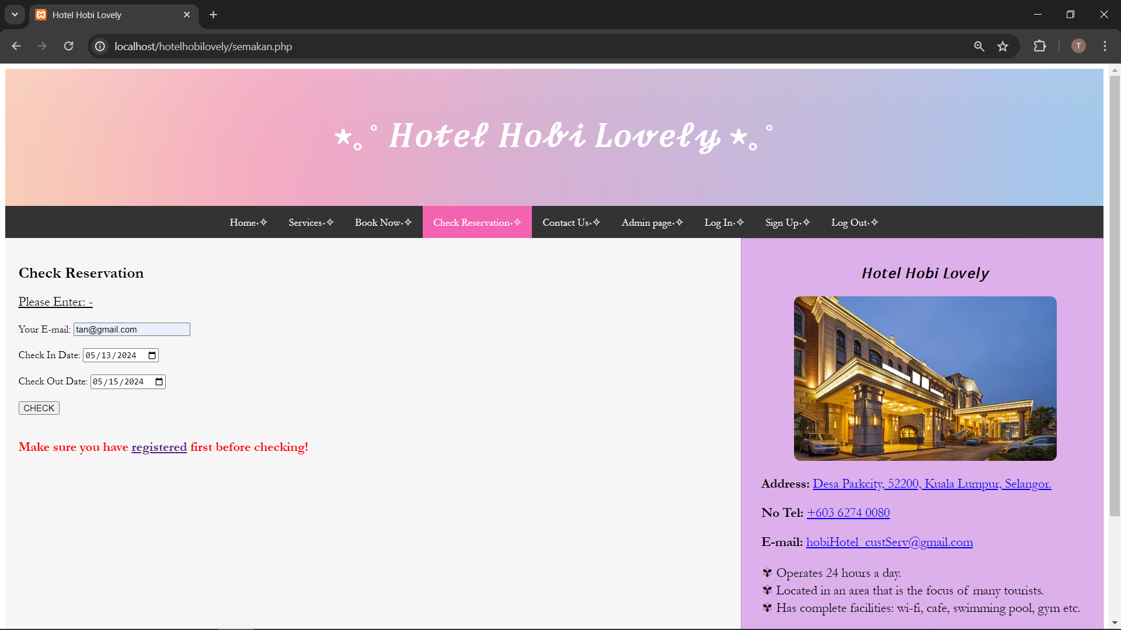
Check Reservation Page

Slide 21
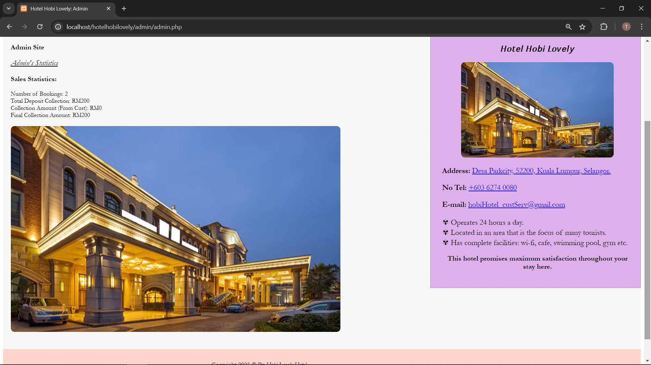
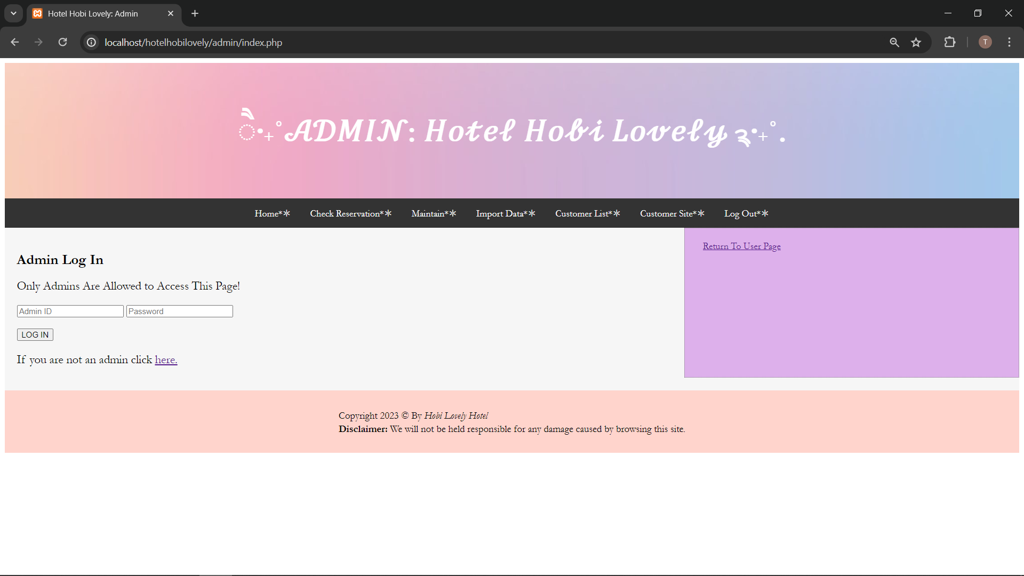
Admin Log In Page

Slide 22
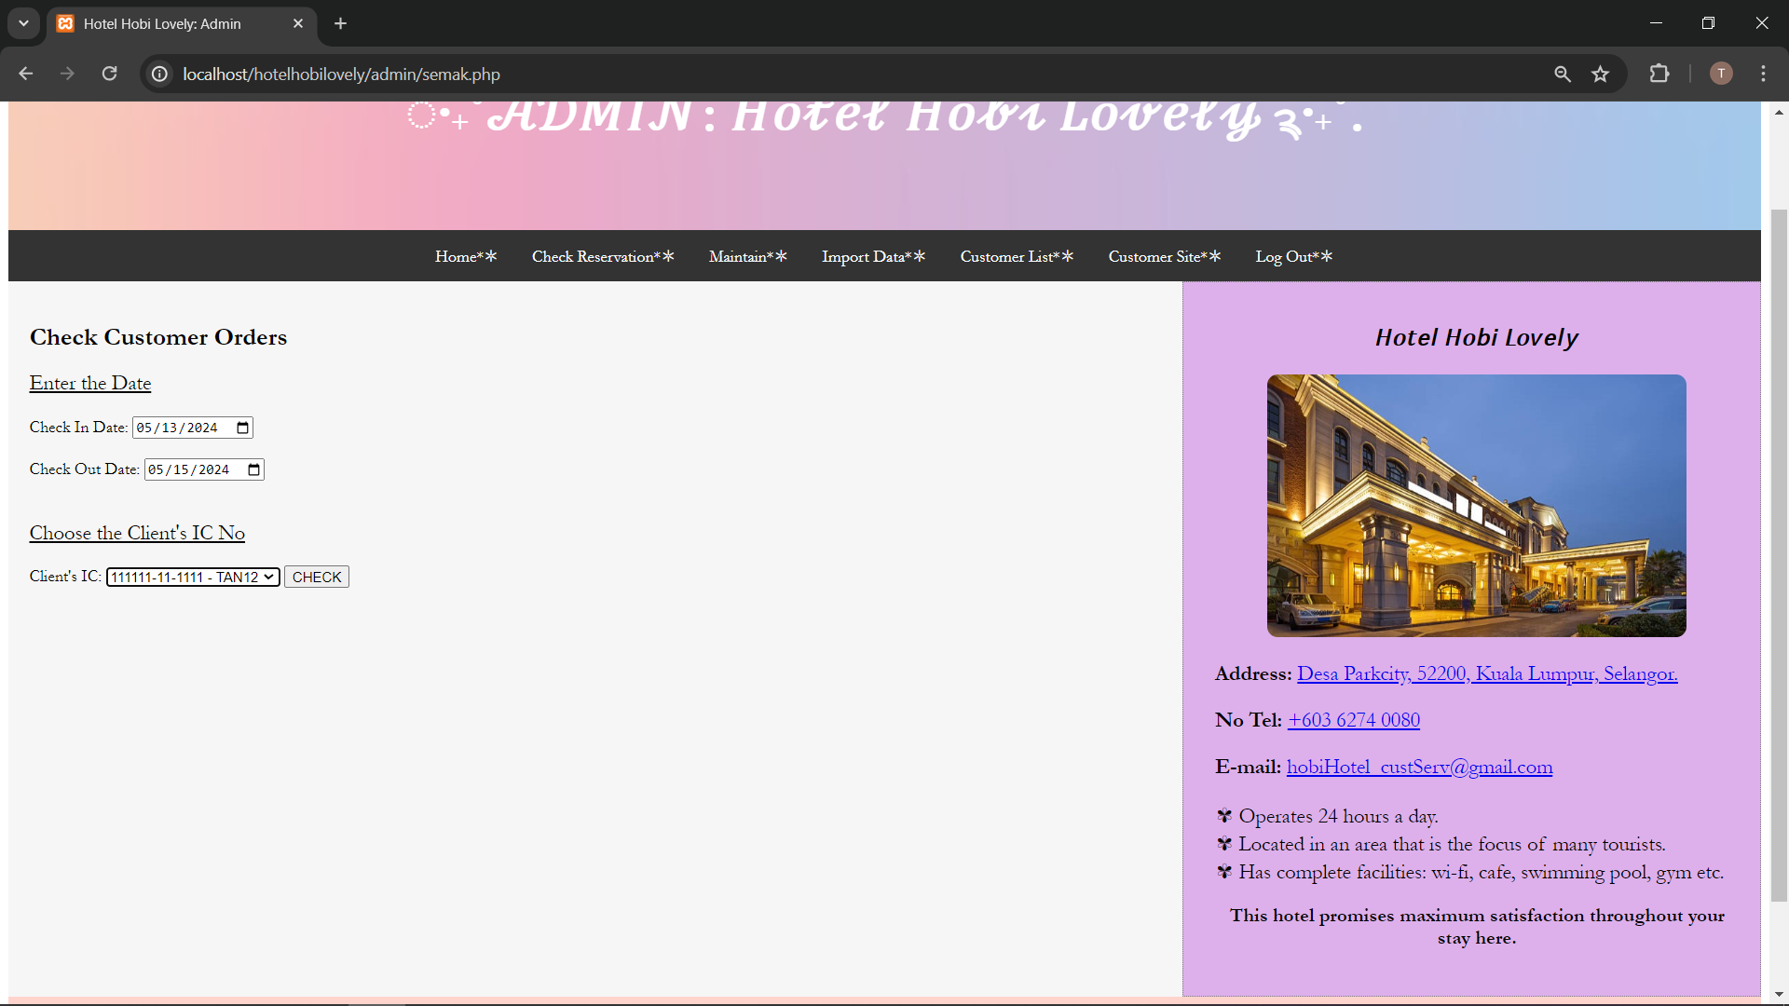
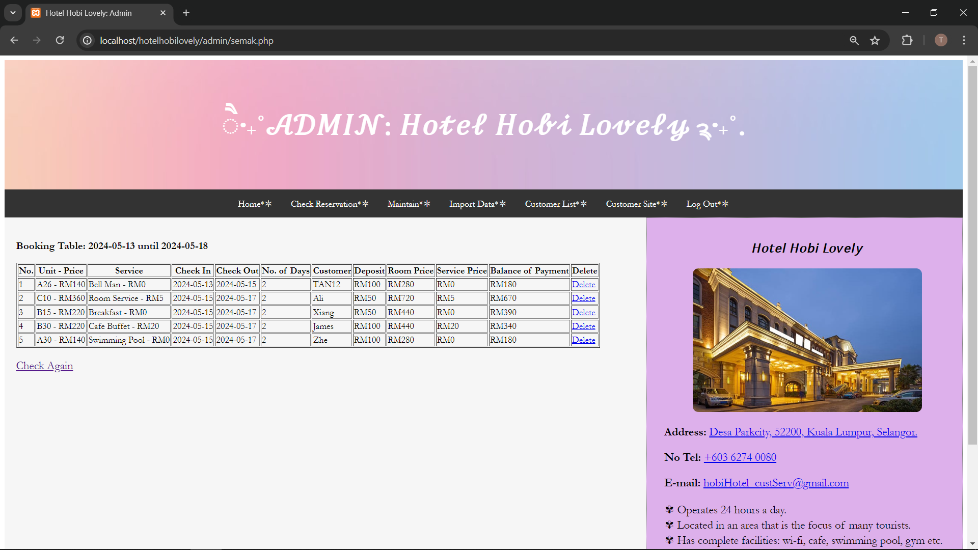
Admin Check Reservation Page

Slide 23
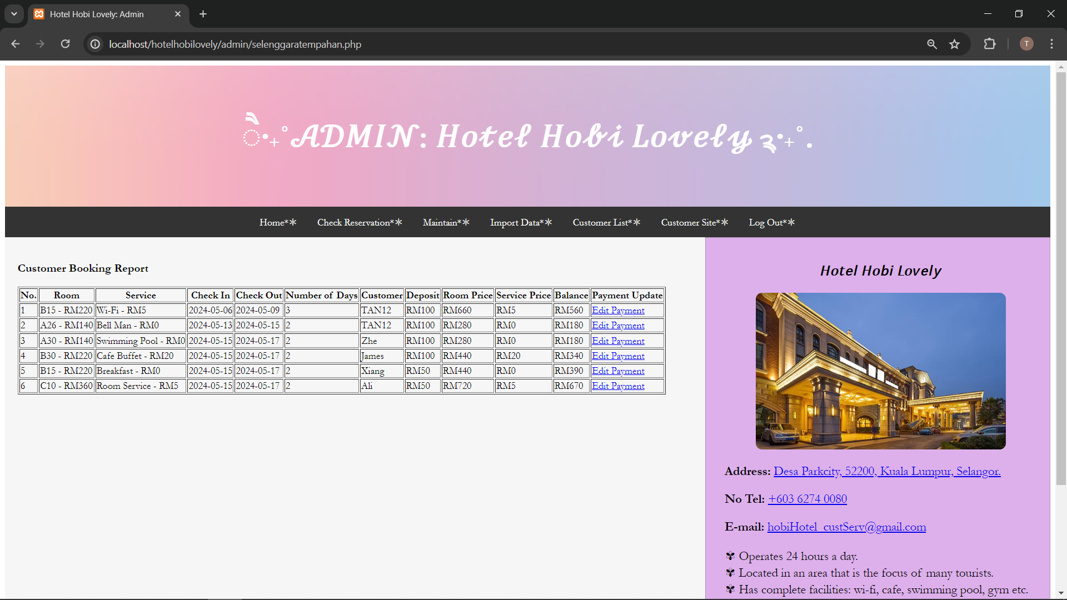
Maintain Customer Payments

Slide 24
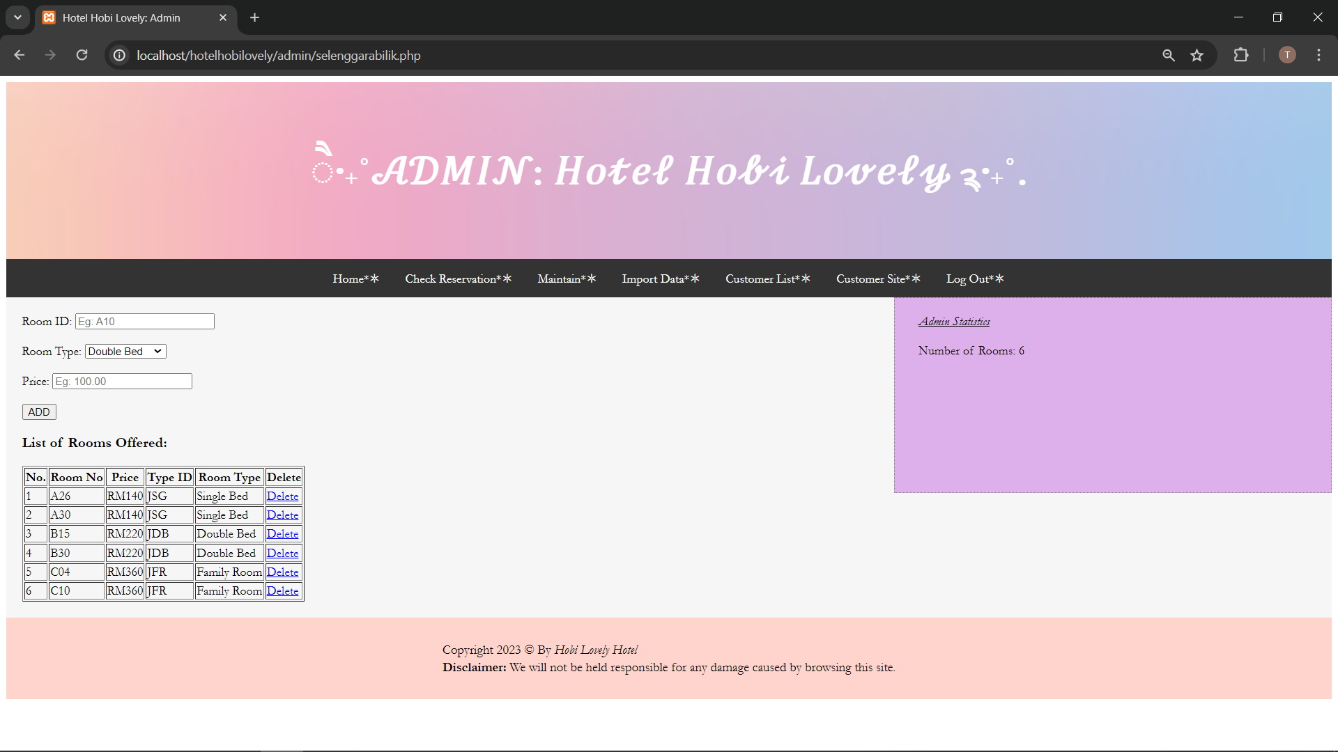
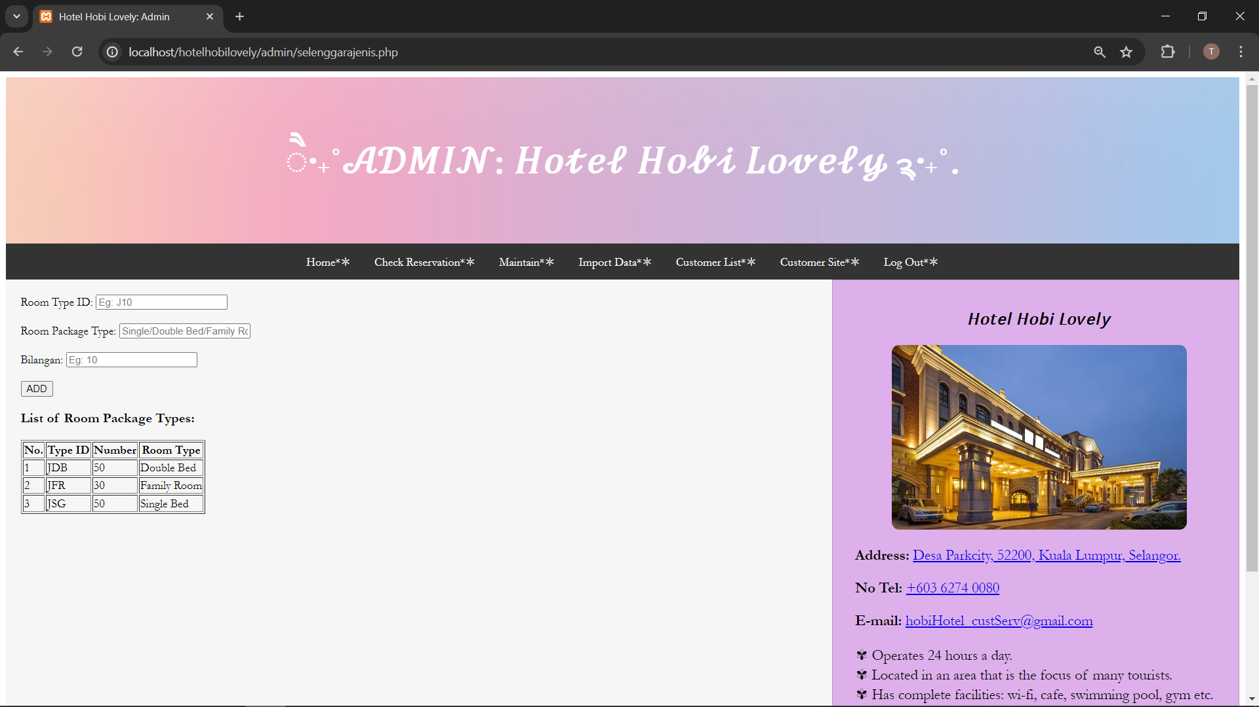
Maintain Room ID
Maintain Room Type

Slide 25
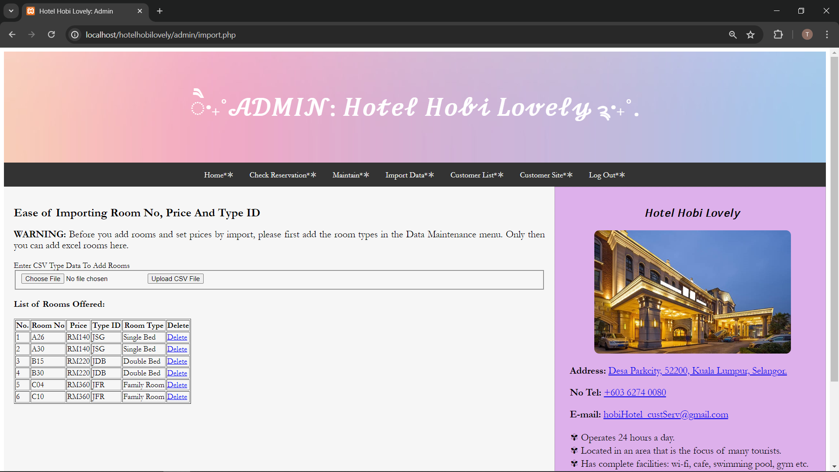
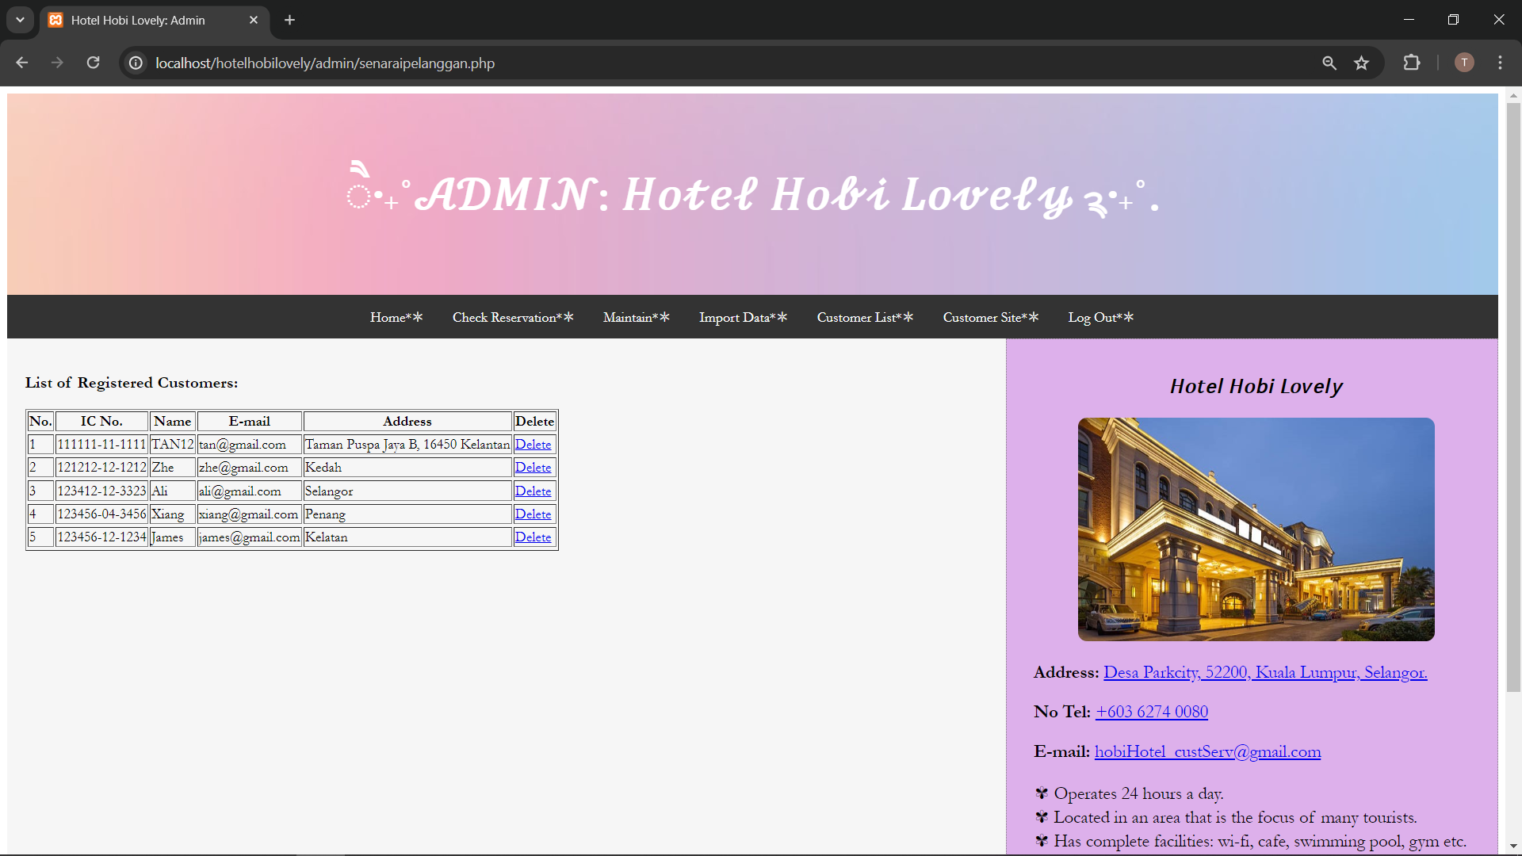
Import Data Page
Customer List

Slide 26
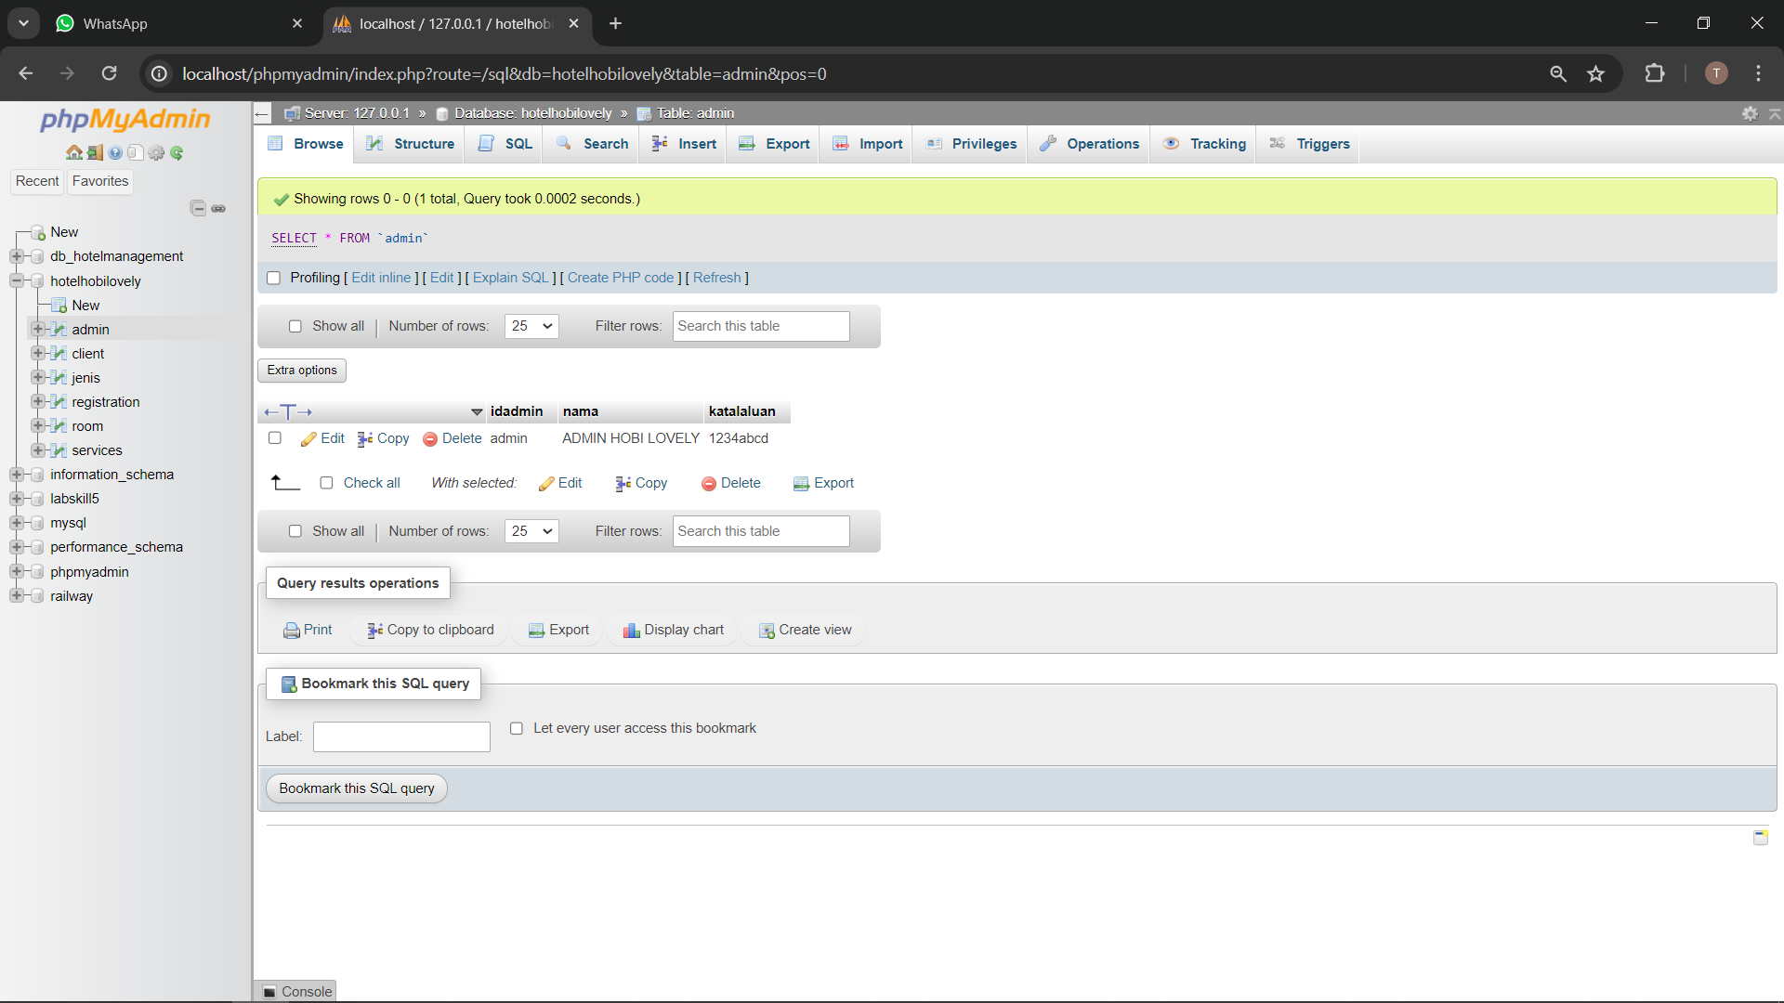
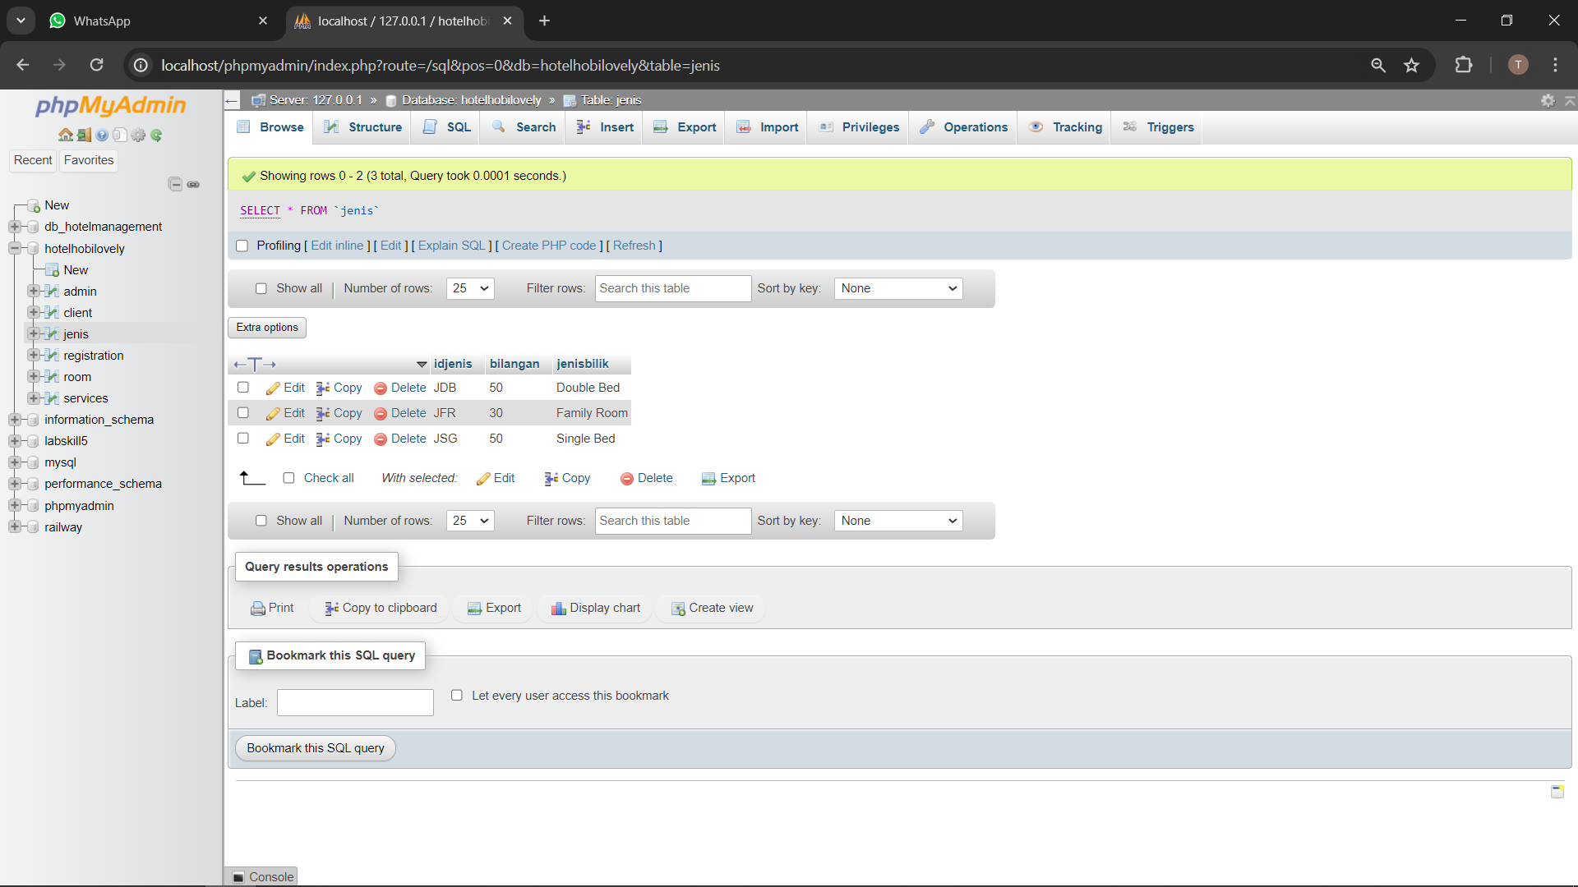
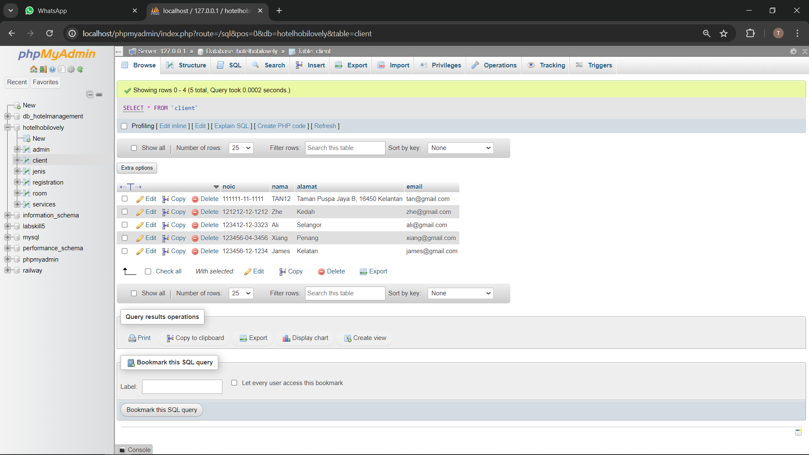
Database For Room Type
Database For Admin
Database For Customer

Slide 27
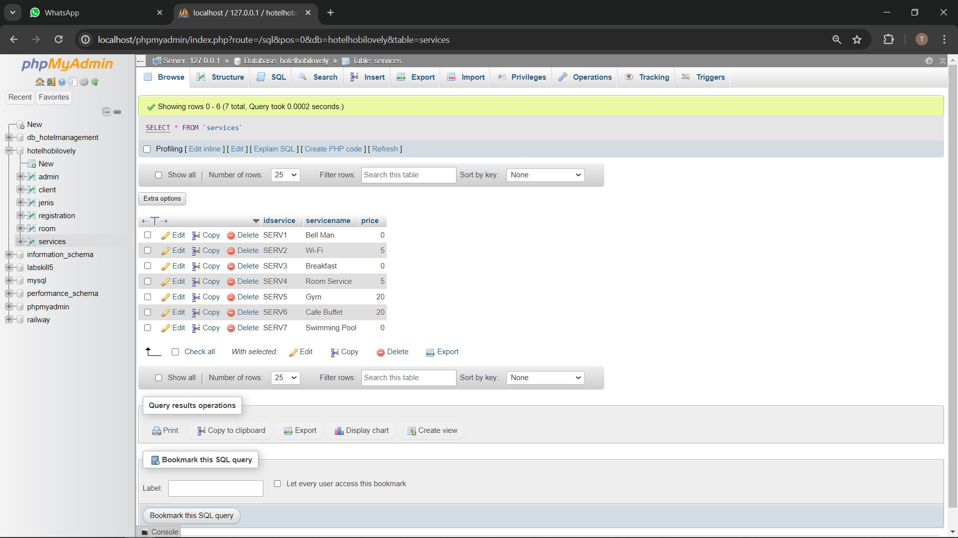
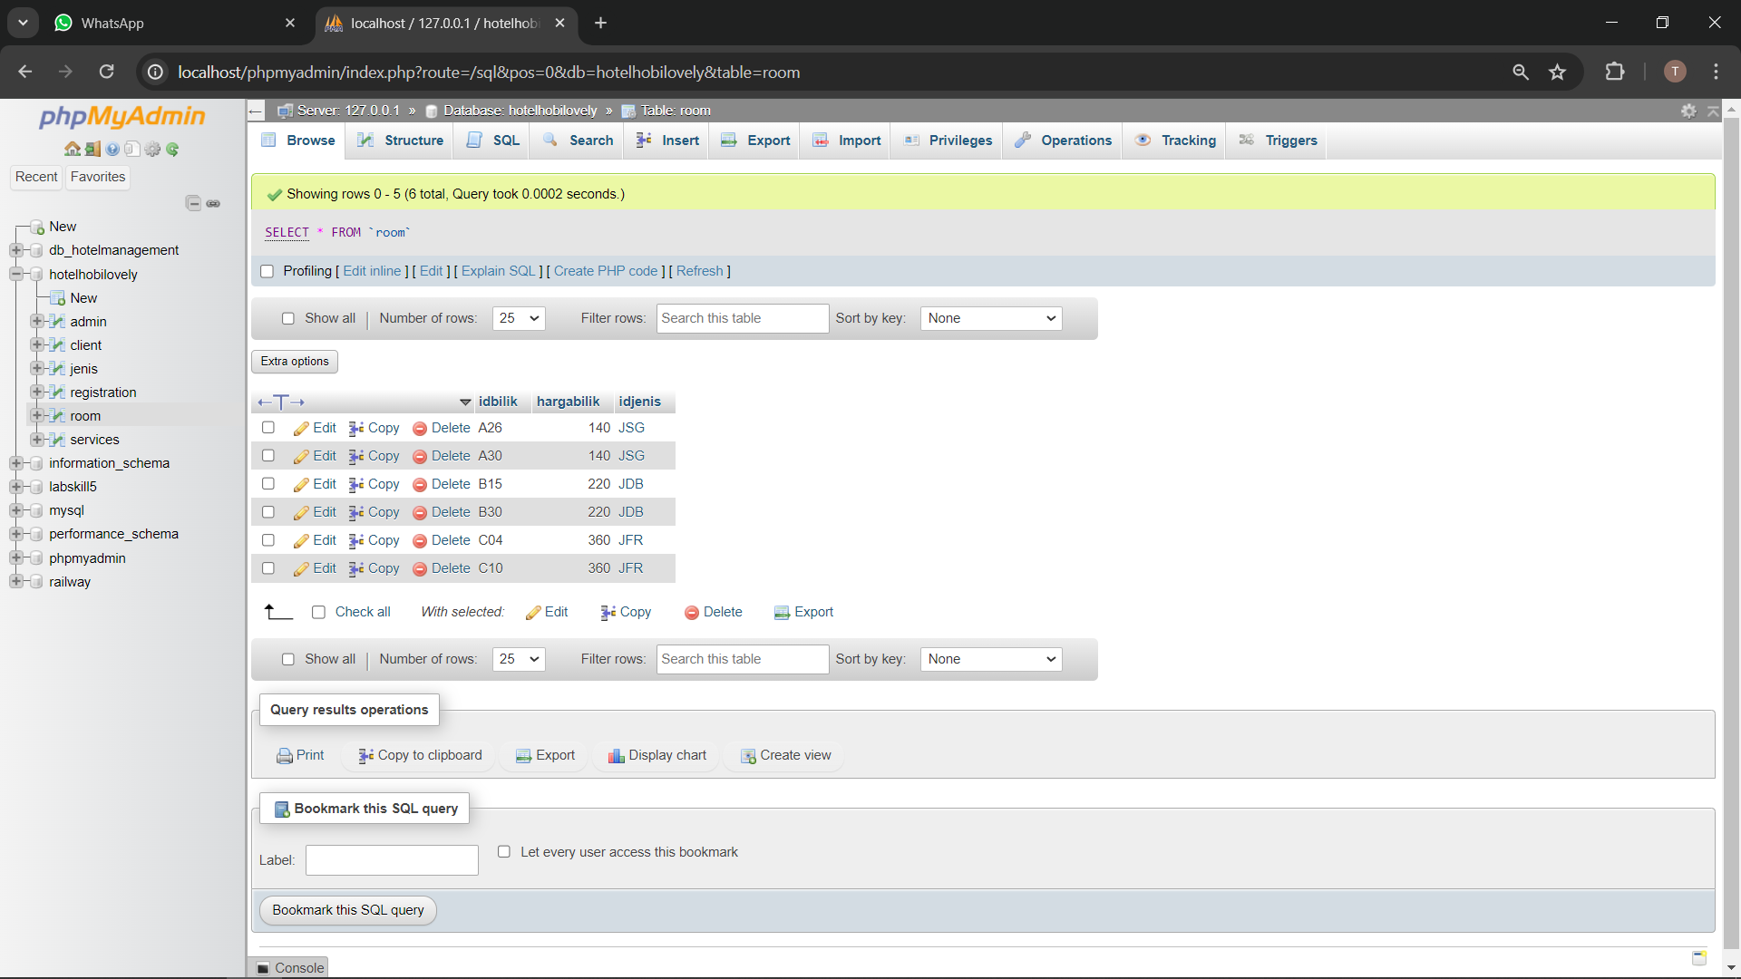
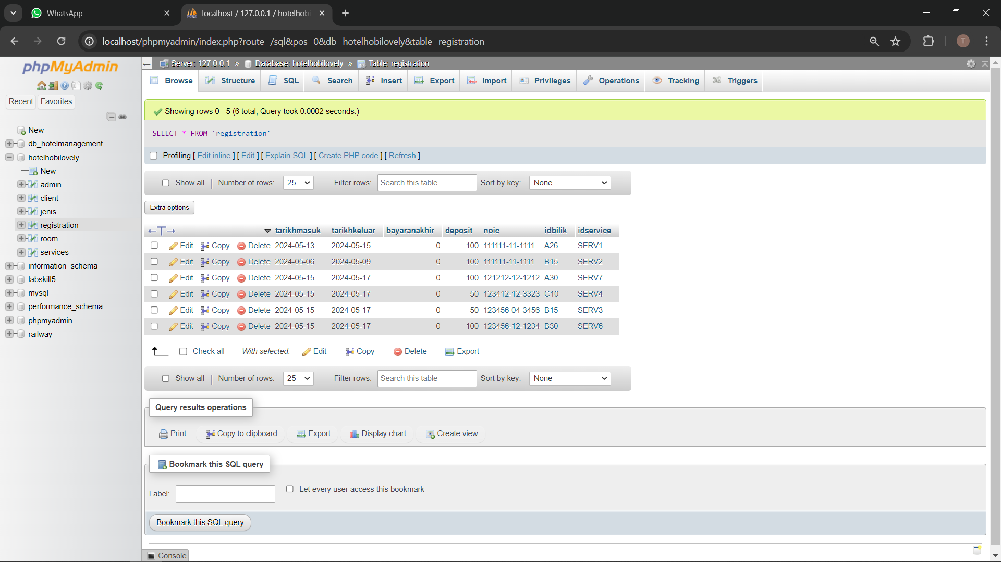
Database For Service
Database For Room
Database For Registration

Slide 28
Thank You

